Slide 1
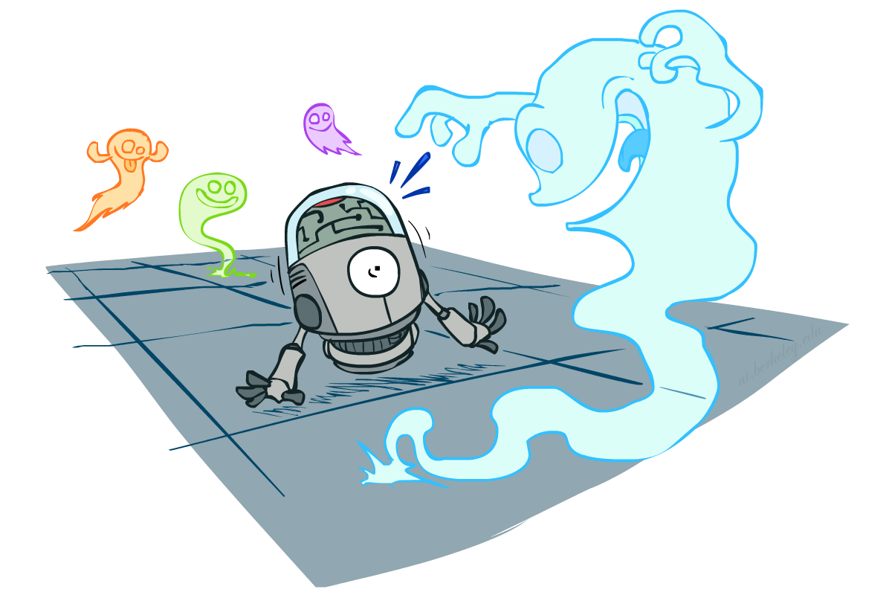
CSE 317: Artificial Intelligence
Probability
[These slides were created by Dan Klein and Pieter Abbeel for CS188 Intro to AI at UC Berkeley.]

Slide 2
Course Topics
Part I: Making Decisions
Fast search / planning
Constraint satisfaction
Adversarial and uncertain search
Part II: Reasoning under Uncertainty
Bayes’ nets
Decision theory
Machine learning
Throughout: Applications
Natural language, vision, robotics, games, …

Slide 3

Today
Probability
Random Variables
Joint and Marginal Distributions
Conditional Distribution
Product Rule, Chain Rule, Bayes’ Rule
Inference
Independence
You’ll need all this stuff A LOT for the next few weeks, so make sure you go over it now!
Notes:
Like “sort this list” or “add these two numbers”

Slide 4
Random Variables
A random variable is some aspect of the world about which we (may) have uncertainty
R = Is it raining?
T = Is it hot or cold?
D = How long will it take to drive to work?
L = Where is the ghost?
We denote random variables with capital letters
Like variables in a CSP, random variables have domains
R in {true, false} (often write as {+r, -r})
T in {hot, cold}
D in [0, ∞)
L in possible locations, maybe {(0,0), (0,1), …}

Slide 5
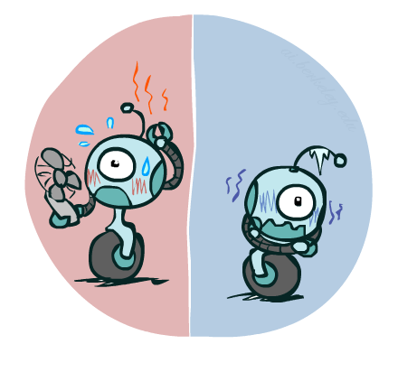

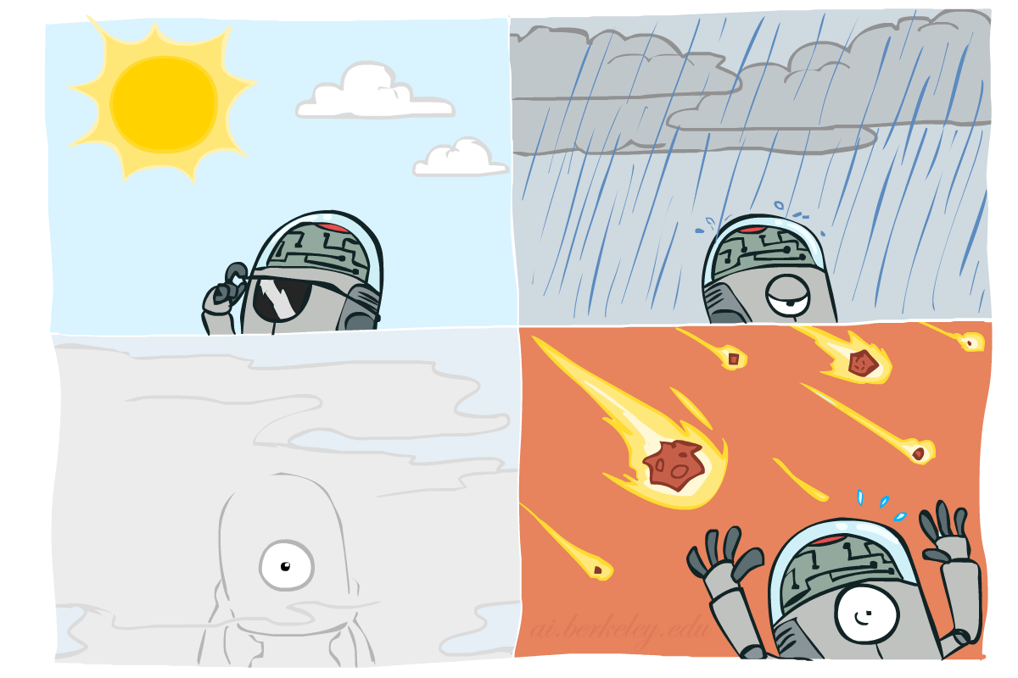

Probability Distributions
Associate a probability with each value
Temperature:
Weather:
W | P
sun | 0.6
rain | 0.1
fog | 0.3
meteor | 0.0
T | P
hot | 0.5
cold | 0.5

Slide 6


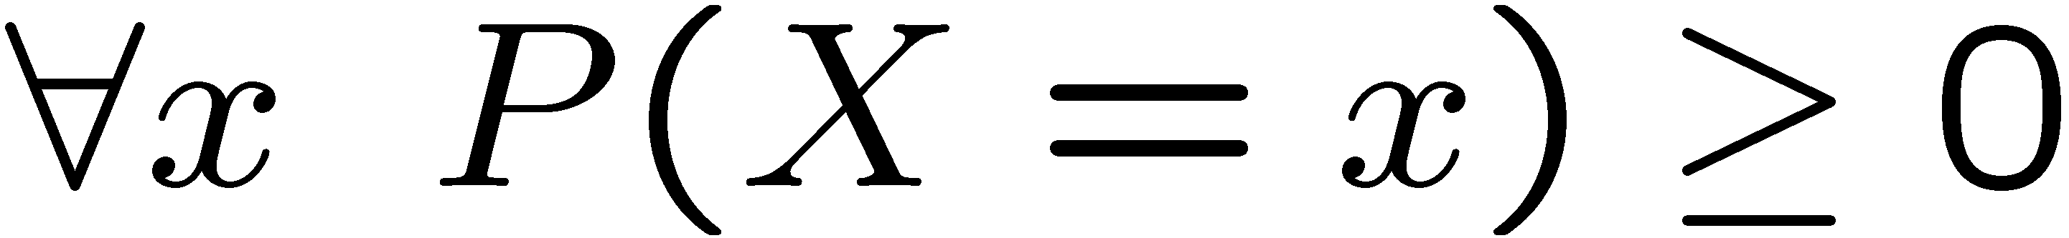
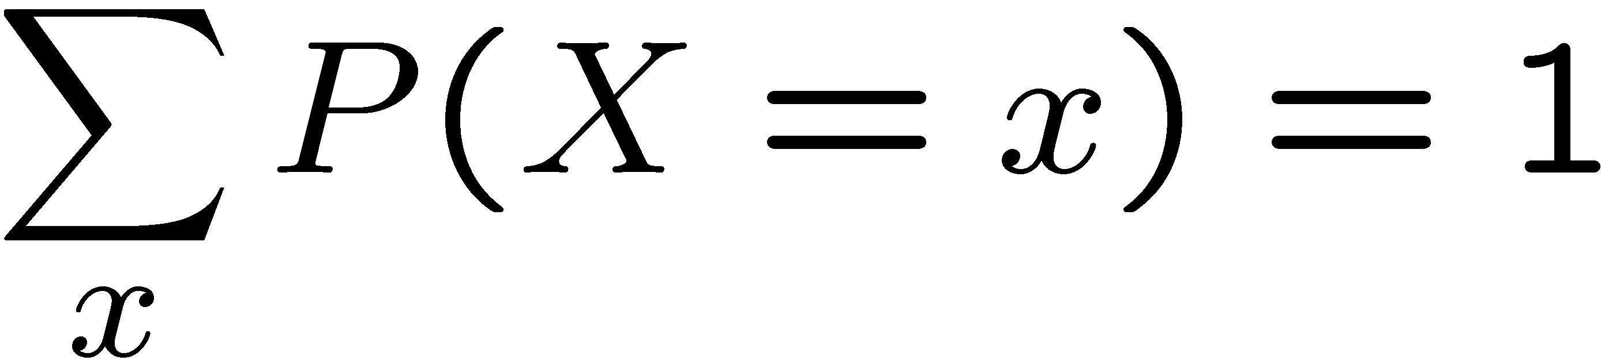
Probability Distributions
Unobserved random variables have distributions
A distribution is a TABLE of probabilities of values
A probability (lower case value) is a single number
Must have: and
Shorthand notation:
OK if all domain entries are unique
T | P
hot | 0.5
cold | 0.5
W | P
sun | 0.6
rain | 0.1
fog | 0.3
meteor | 0.0

Slide 7




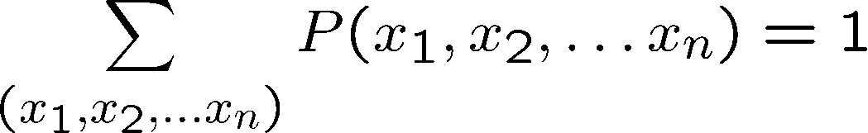
Joint Distributions
A joint distribution over a set of random variables:
specifies a real number for each assignment (or outcome):
Must obey:
Size of distribution if n variables with domain sizes d?
For all but the smallest distributions, impractical to write out!
T | W | P
hot | sun | 0.4
hot | rain | 0.1
cold | sun | 0.2
cold | rain | 0.3

Slide 8
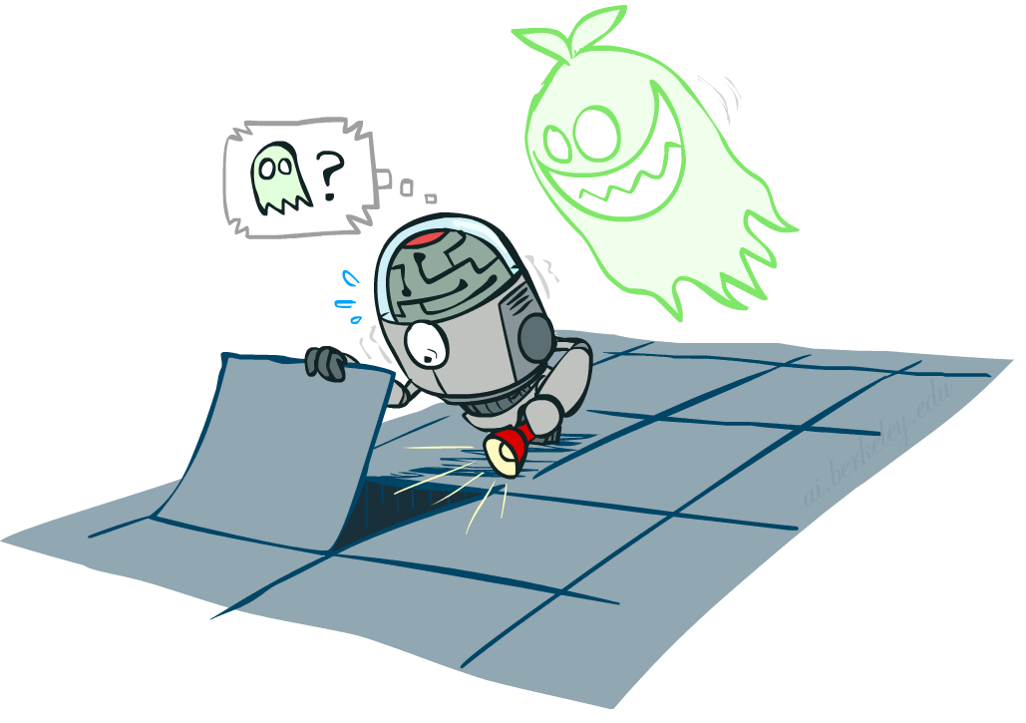

Probabilistic Models
Distribution over T,W
A probabilistic model is a joint distribution over a set of random variables
Probabilistic models:
(Random) variables with domains
Assignments are called outcomes
Joint distributions: say whether assignments (outcomes) are likely
Normalized: sum to 1.0
Ideally: only certain variables directly interact
Constraint satisfaction problems:
Variables with domains
Constraints: state whether assignments are possible
Ideally: only certain variables directly interact
T | W | P
hot | sun | 0.4
hot | rain | 0.1
cold | sun | 0.2
cold | rain | 0.3
Constraint over T,W
T | W | P
hot | sun | T
hot | rain | F
cold | sun | F
cold | rain | T

Slide 9
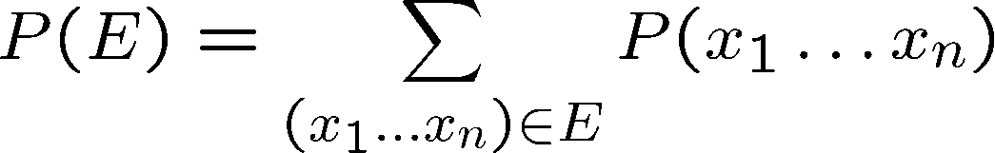
Events
An event is a set E of outcomes
From a joint distribution, we can calculate the probability of any event
Probability that it’s hot AND sunny?
Probability that it’s hot?
Probability that it’s hot OR sunny?
Typically, the events we care about are partial assignments, like P(T=hot)
T | W | P
hot | sun | 0.4
hot | rain | 0.1
cold | sun | 0.2
cold | rain | 0.3

Slide 10
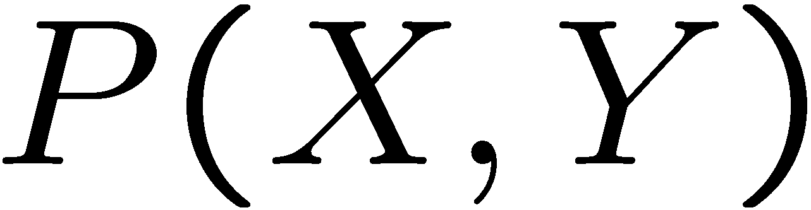
Quiz: Events
P(+x, +y) ?
P(+x) ?
P(-y OR +x) ?
X | Y | P
+x | +y | 0.2
+x | -y | 0.3
-x | +y | 0.4
-x | -y | 0.1

Slide 11
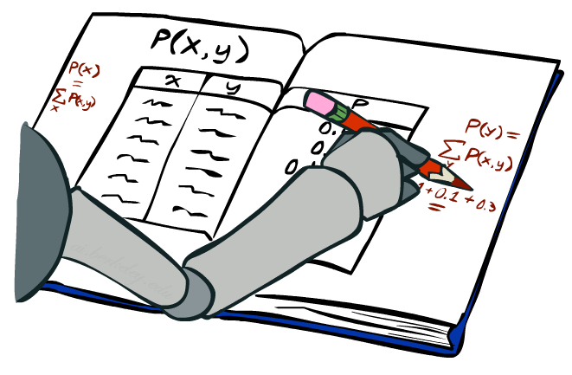
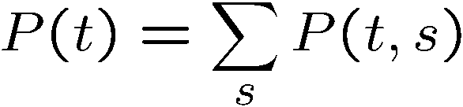
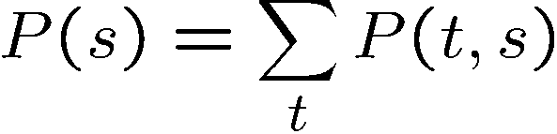
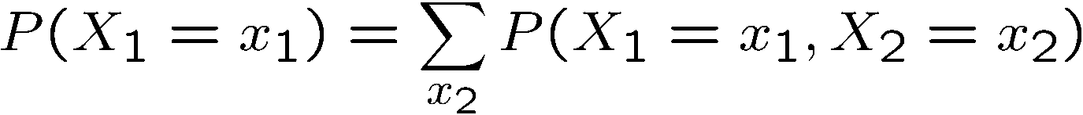
Marginal Distributions
Marginal distributions are sub-tables which eliminate variables
Marginalization (summing out): Combine collapsed rows by adding
T | P
hot | 0.5
cold | 0.5
T | W | P
hot | sun | 0.4
hot | rain | 0.1
cold | sun | 0.2
cold | rain | 0.3
W | P
sun | 0.6
rain | 0.4

Slide 12
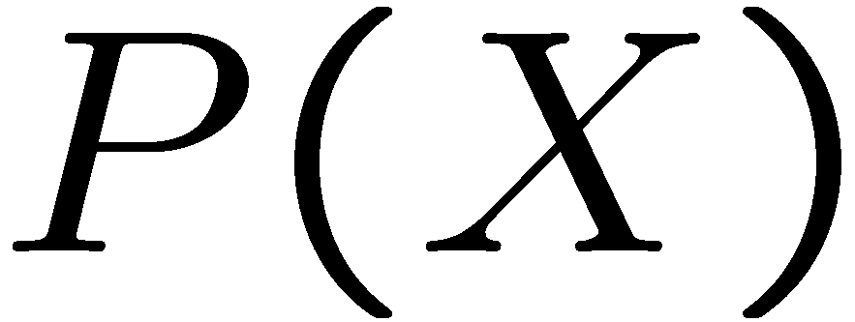
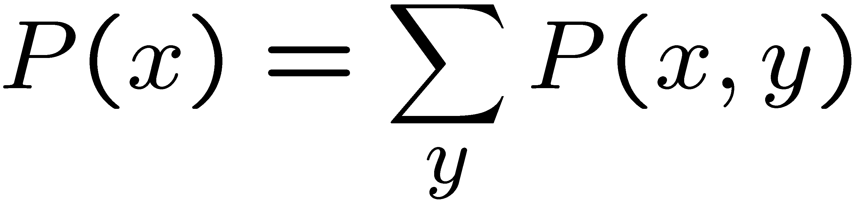
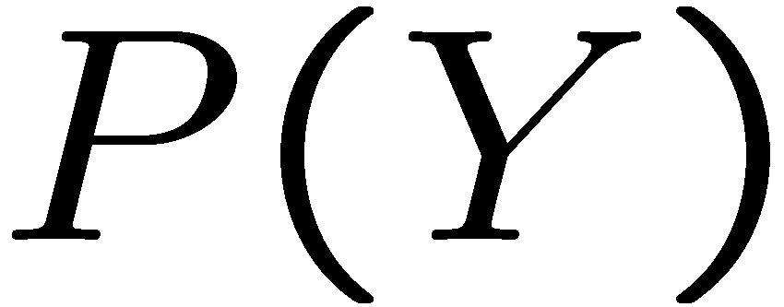
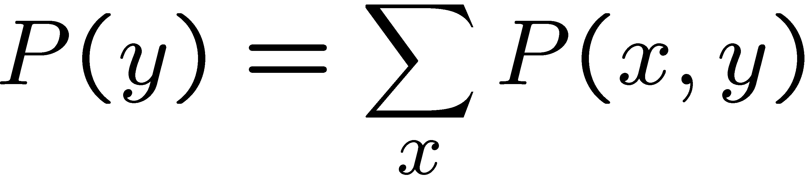
Quiz: Marginal Distributions
X | P
+x
-x
X | Y | P
+x | +y | 0.2
+x | -y | 0.3
-x | +y | 0.4
-x | -y | 0.1
Y | P
+y
-y

Slide 13
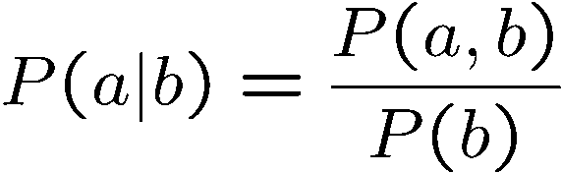
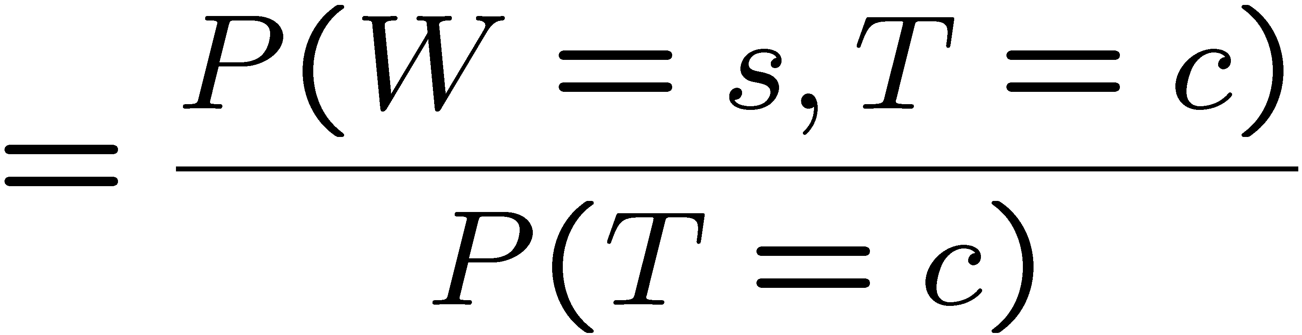
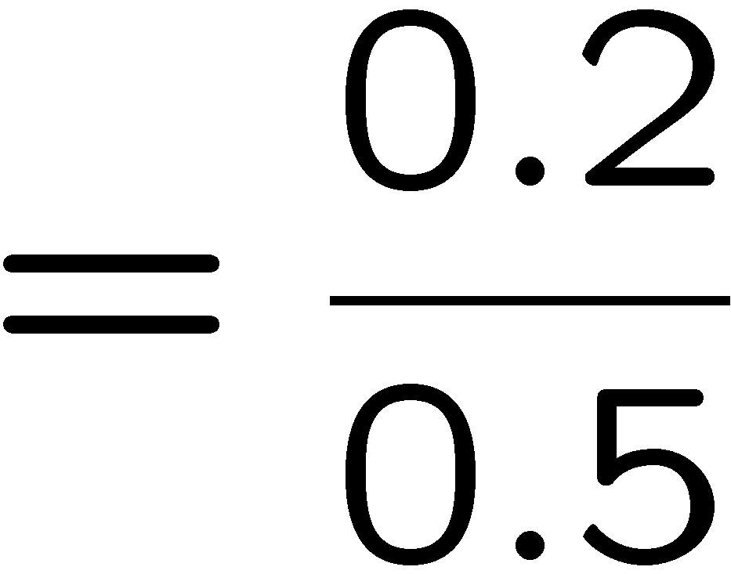



Conditional Probabilities
A simple relation between joint and conditional probabilities
In fact, this is taken as the definition of a conditional probability
P(a,b)
P(a)
P(b)
T | W | P
hot | sun | 0.4
hot | rain | 0.1
cold | sun | 0.2
cold | rain | 0.3

Slide 14
Quiz: Conditional Probabilities
P(+x | +y) ?
P(-x | +y) ?
P(-y | +x) ?
X | Y | P
+x | +y | 0.2
+x | -y | 0.3
-x | +y | 0.4
-x | -y | 0.1

Slide 15



Conditional Distributions
Conditional distributions are probability distributions over some variables given fixed values of others
Conditional Distributions
Joint Distribution
W | P
sun | 0.8
rain | 0.2
T | W | P
hot | sun | 0.4
hot | rain | 0.1
cold | sun | 0.2
cold | rain | 0.3
W | P
sun | 0.4
rain | 0.6

Slide 16

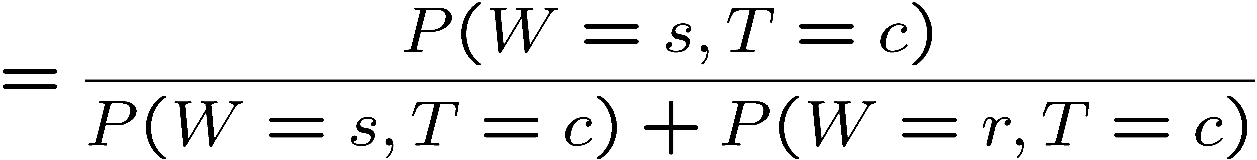
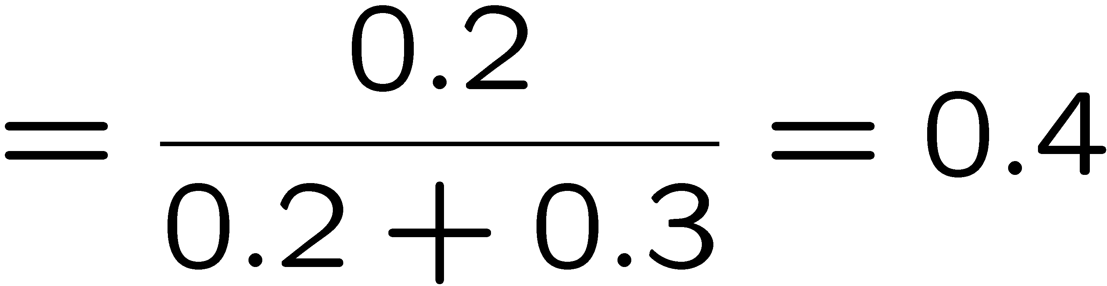
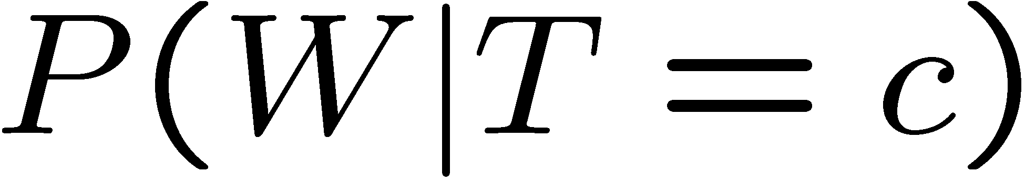
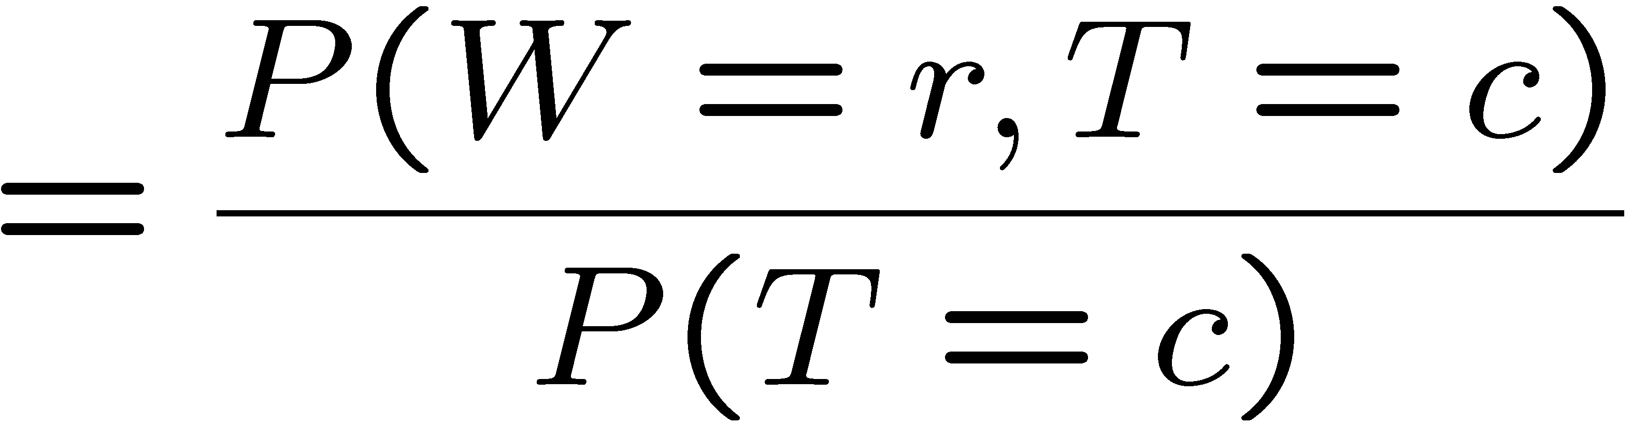

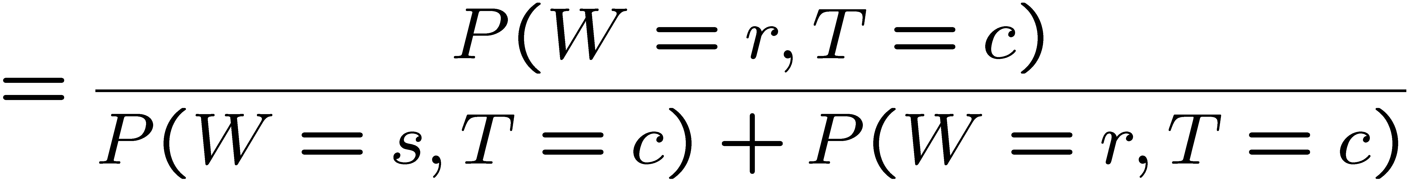
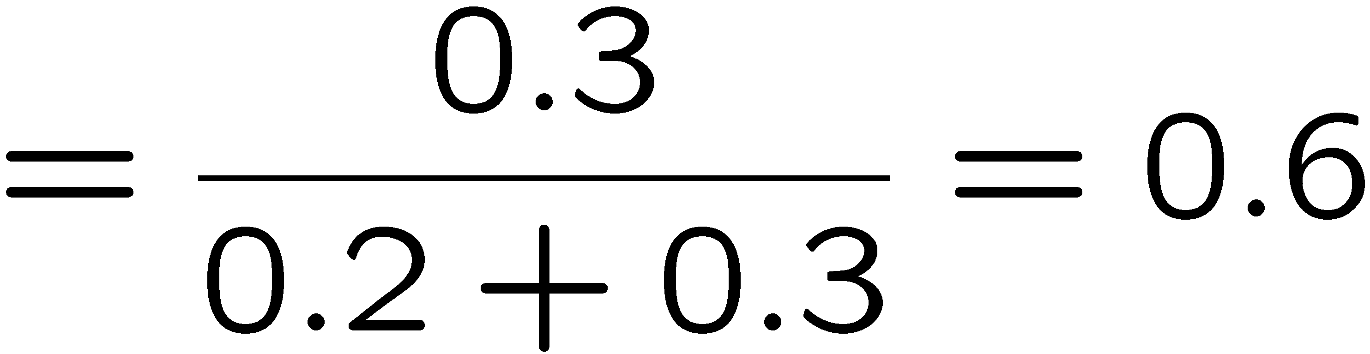
Normalization Trick
T | W | P
hot | sun | 0.4
hot | rain | 0.1
cold | sun | 0.2
cold | rain | 0.3
W | P
sun | 0.4
rain | 0.6

Slide 17
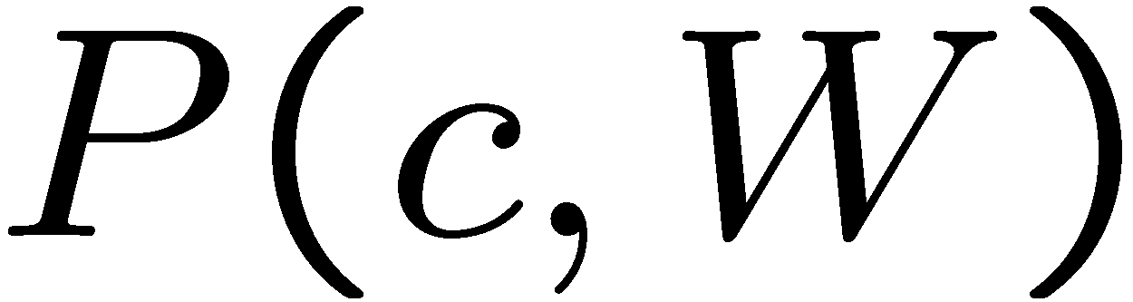
Normalization Trick
SELECT the joint probabilities matching the evidence
NORMALIZE the selection
(make it sum to one)
T | W | P
hot | sun | 0.4
hot | rain | 0.1
cold | sun | 0.2
cold | rain | 0.3
T | W | P
cold | sun | 0.2
cold | rain | 0.3
W | P
sun | 0.4
rain | 0.6

Slide 18
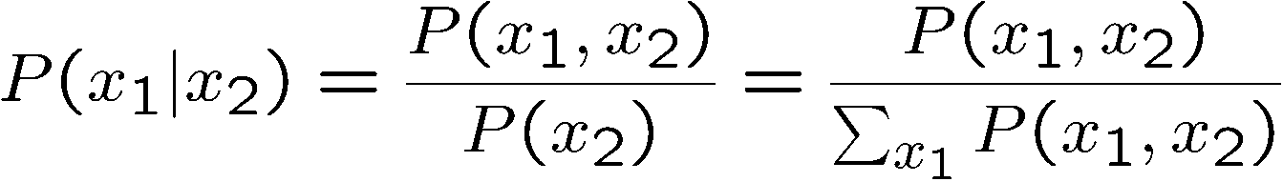
Normalization Trick
SELECT the joint probabilities matching the evidence
NORMALIZE the selection
(make it sum to one)
T | W | P
hot | sun | 0.4
hot | rain | 0.1
cold | sun | 0.2
cold | rain | 0.3
T | W | P
cold | sun | 0.2
cold | rain | 0.3
W | P
sun | 0.4
rain | 0.6
Why does this work? Sum of selection is P(evidence)! (P(T=c), here)

Slide 19
Quiz: Normalization Trick
P(X | Y=-y) ?
SELECT the joint probabilities matching the evidence
NORMALIZE the selection
(make it sum to one)
X | Y | P
+x | +y | 0.2
+x | -y | 0.3
-x | +y | 0.4
-x | -y | 0.1

Slide 20
To Normalize
(Dictionary) To bring or restore to a normal condition
Procedure:
Step 1: Compute Z = sum over all entries
Step 2: Divide every entry by Z
Example 1
All entries sum to ONE
Example 2
W | P
sun | 0.2
rain | 0.3
Normalize
W | P
sun | 0.4
rain | 0.6
T | W | P
hot | sun | 20
hot | rain | 5
cold | sun | 10
cold | rain | 15
T | W | P
hot | sun | 0.4
hot | rain | 0.1
cold | sun | 0.2
cold | rain | 0.3
Normalize
Z = 0.5
Z = 50

Slide 21


Normalization Trick
A trick to get a whole conditional distribution at once:
Select the joint probabilities matching the evidence
Normalize the selection (make it sum to one)
Why does this work? Sum of selection is P(evidence)! (P(r), here)
T | W | P
hot | sun | 0.4
hot | rain | 0.1
cold | sun | 0.2
cold | rain | 0.3
T | R | P
hot | rain | 0.1
cold | rain | 0.3
T | P
hot | 0.25
cold | 0.75
Select
Normalize

Slide 22
Conditional Distributions
Conditional distributions are probability distributions over some variables given fixed values of others
Conditional Distributions
Joint Distribution
W | P
sun | 0.8
rain | 0.2
T | W | P
hot | sun | 0.4
hot | rain | 0.1
cold | sun | 0.2
cold | rain | 0.3
W | P
sun | 0.4
rain | 0.6

Slide 23

Probabilistic Inference
Probabilistic inference: compute a desired probability from other known probabilities (e.g. conditional from joint)
We generally compute conditional probabilities
P(on time | no reported accidents) = 0.90
These represent the agent’s beliefs given the evidence
Probabilities change with new evidence:
P(on time | no accidents, 5 a.m.) = 0.95
P(on time | no accidents, 5 a.m., raining) = 0.80
Observing new evidence causes beliefs to be updated

Slide 24





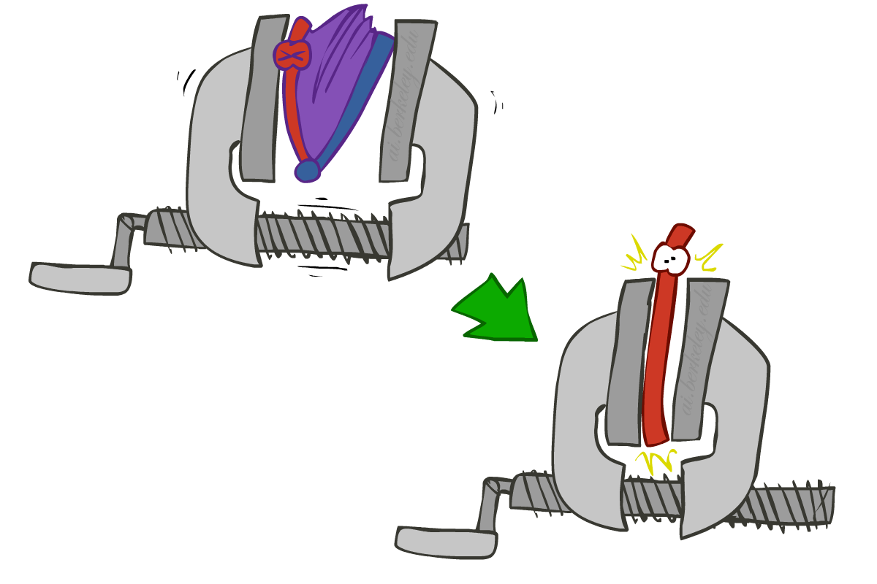
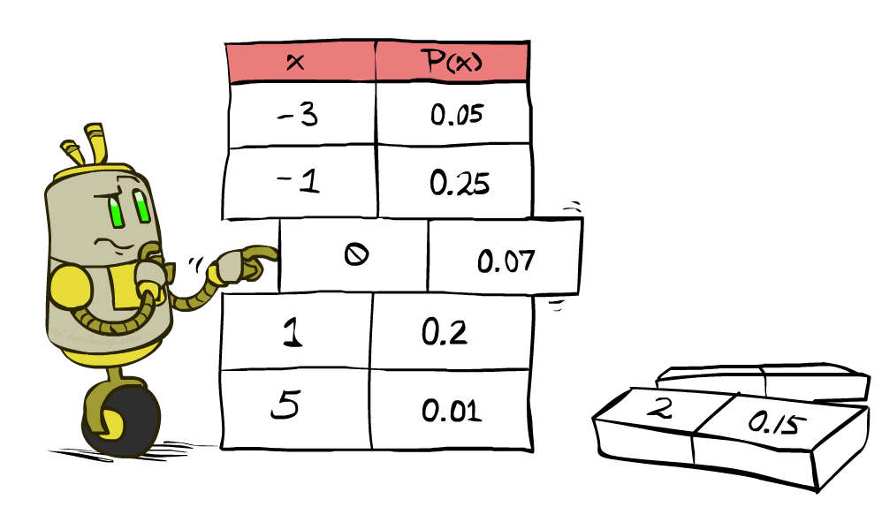


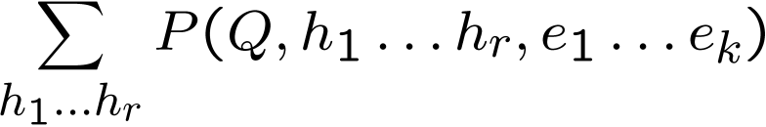
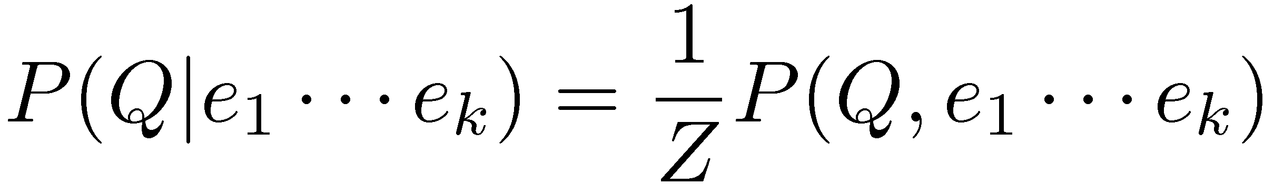
Inference by Enumeration
* Works fine with multiple query variables, too
General case:
Evidence variables:
Query* variable:
Hidden variables:
We want:
All variables
Step 1: Select the entries consistent with the evidence
Step 2: Sum out H to get joint of Query and evidence
Step 3: Normalize

Slide 25
Inference by Enumeration
P(W)?
P(W | winter)?
P(W | winter, hot)?
S | T | W | P
summer | hot | sun | 0.30
summer | hot | rain | 0.05
summer | cold | sun | 0.10
summer | cold | rain | 0.05
winter | hot | sun | 0.10
winter | hot | rain | 0.05
winter | cold | sun | 0.15
winter | cold | rain | 0.20

Slide 26
Inference by Enumeration
Obvious problems:
Worst-case time complexity O(d^{n})
Space complexity O(d^{n}) to store the joint distribution

Slide 27
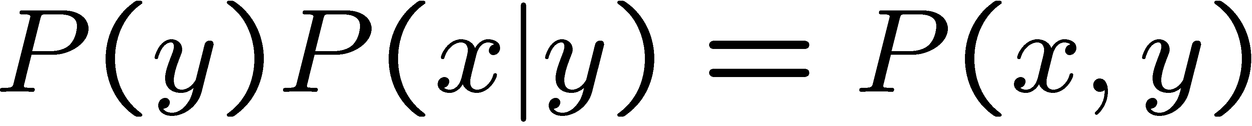
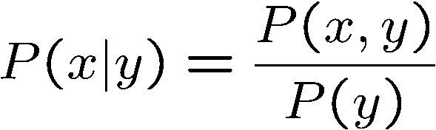
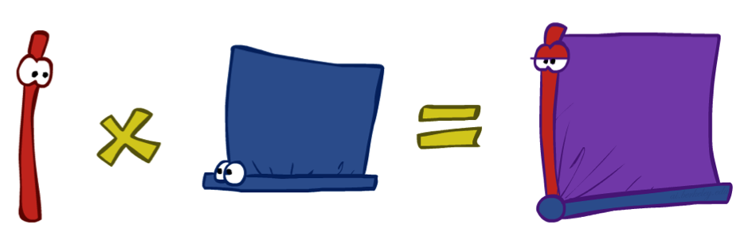
The Product Rule
Sometimes have conditional distributions but want the joint

Slide 28


The Product Rule
Example:
D | W | P
wet | sun | 0.1
dry | sun | 0.9
wet | rain | 0.7
dry | rain | 0.3
D | W | P
wet | sun | 0.08
dry | sun | 0.72
wet | rain | 0.14
dry | rain | 0.06
R | P
sun | 0.8
rain | 0.2

Slide 29
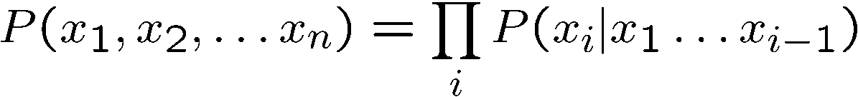
The Chain Rule
More generally, can always write any joint distribution as an incremental product of conditional distributions
Why is this always true?

Slide 30


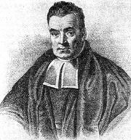
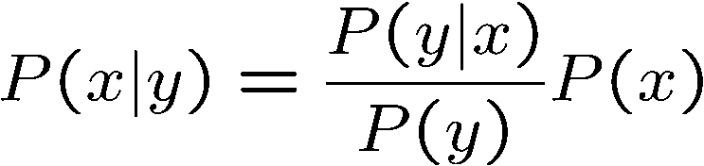
Bayes’ Rule
Two ways to factor a joint distribution over two variables:
Dividing, we get:
Why is this at all helpful?
Lets us build one conditional from its reverse
Often one conditional is tricky but the other one is simple
Foundation of many systems we’ll see later (e.g. ASR, MT)
In the running for most important AI equation!
That’s my rule!

Slide 31
Inference with Bayes’ Rule
Example: Diagnostic probability from causal probability:
Example:
M: meningitis, S: stiff neck
Note: posterior probability of meningitis still very small
Note: you should still get stiff necks checked out! Why?
Example
givens

Slide 32
Quiz: Bayes’ Rule
Given:
What is P(W | dry) ?
D | W | P
wet | sun | 0.1
dry | sun | 0.9
wet | rain | 0.7
dry | rain | 0.3
R | P
sun | 0.8
rain | 0.2

